Slide 1
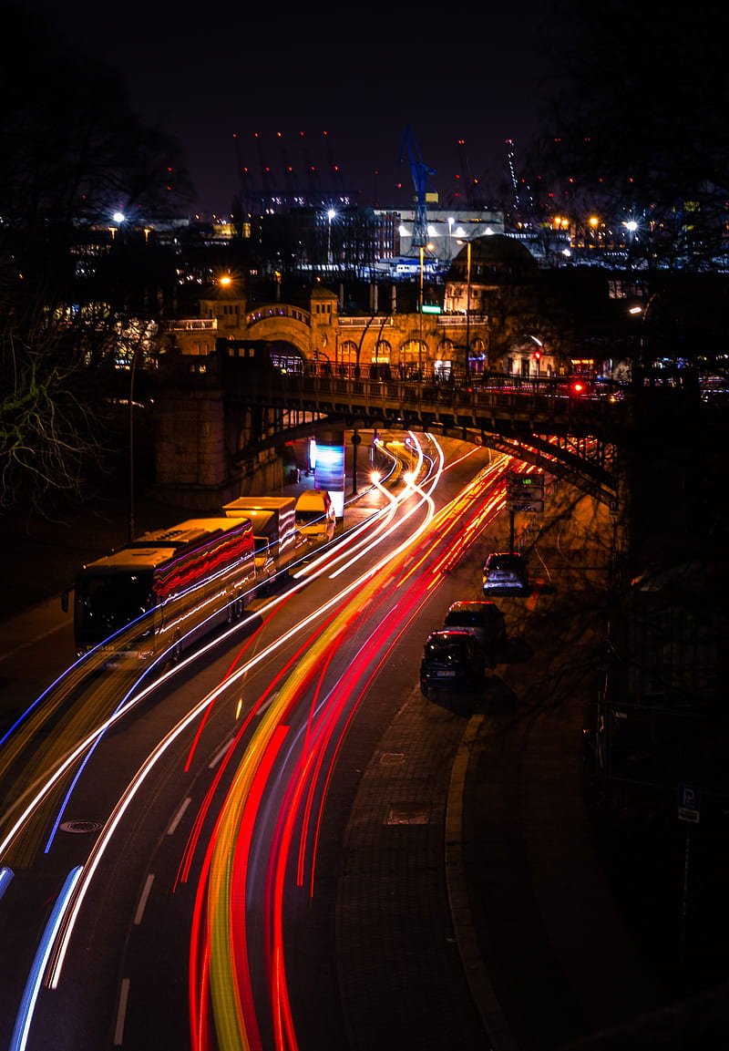

Traffic Flow Prediction Using Graph Neural Networks

Slide 2
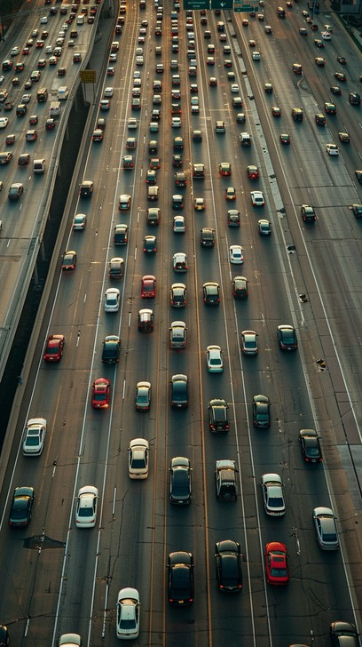
Introduction to Traffic Flow Prediction
Benefits of Accurate Prediction
Limitations of Traditional Models
Accurate traffic prediction supports better route planning, congestion management, and smarter urban infrastructure, making cities more efficient and environmentally friendly.
Traditional models such as ARIMA and LSTM primarily focus on temporal trends, often failing to capture spatial relationships between road segments that are crucial in real-world traffic systems.
Complex Dependencies
Complex spatial-temporal dependencies in urban traffic networks necessitate new approaches capable of jointly learning spatial and temporal patterns.

Slide 3
Limitations of Traditional Traffic Prediction Methods
Statistical Models
Deep Learning Models
Non-Euclidean Nature
Statistical models like ARIMA treat traffic flow as isolated time series, neglecting the influence of surrounding roads and interactions between neighboring intersections.
Deep learning models such as LSTM and CNN capture temporal or local spatial patterns but assume grid-like data structures, making them inadequate for irregular, graph-structured traffic systems.
Traffic networks are inherently non-Euclidean graphs where intersections are nodes and roads are edges; models must understand complex relationships beyond simple sequences or grids.

Slide 4
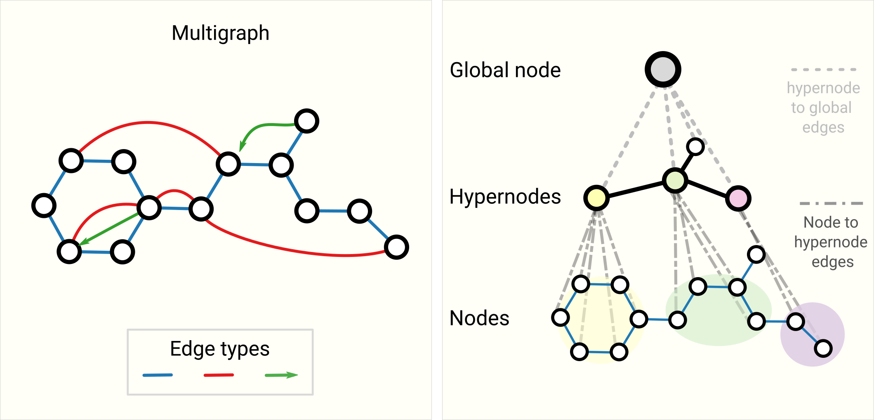
Understanding Graph Neural Networks (GNNs)
Specialized Deep Learning
Graph Neural Networks (GNNs) are specialized deep learning models designed to learn from graph-structured data, capturing relationships between connected entities like roads and intersections.
Message Passing
Nodes aggregate feature information from their neighbors through iterative message passing, allowing them to learn rich, context-aware representations.
Popular Architectures
Popular GNN architectures include Graph Convolutional Networks (GCN), Graph Attention Networks (GAT), and GraphSAGE, each improving how information is aggregated and processed.
https://distill.pub/2021/gnn-intro/

Slide 5
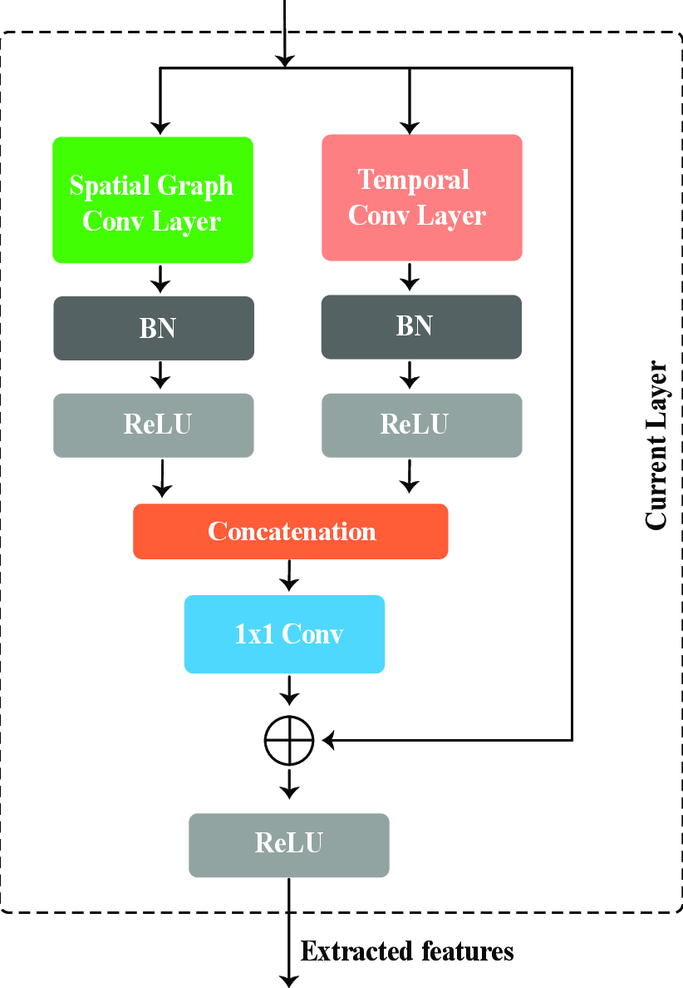
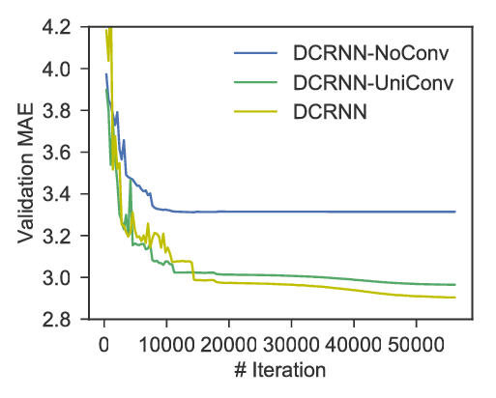
Literature Review : Key GNN Models
DCRNN
STGCN
DCRNN models traffic as a diffusion process across a directed graph and uses Gated Recurrent Units (GRUs) to capture temporal dependencies effectively over time and space.
STGCN replaces recurrent networks with temporal convolution layers, achieving faster training times and maintaining high prediction accuracy across multiple traffic datasets.
Performance Improvements
Both models demonstrated strong performance improvements compared to conventional deep learning methods on benchmark datasets like METR-LA and PEMS-BAY.
https://www.researchgate.net/figure/Learning-curve-for-DCRNN-and-DCRNN-without-diffusion-convolution-Removing-diffusion_fig3_318316069

Slide 6
Literature Review : Advanced GNN Models
Model
Key Innovation
Advantage
Graph WaveNet
Learns adjacency matrices dynamically during training
Discovers hidden spatial dependencies not pre-defined by physical road layouts
ASTGCN
Introduces spatial and temporal attention mechanisms
Enables focus on critical nodes and important time steps for better forecasting
STDGAT
Adapts graph structures dynamically during inference
Provides better resilience against real-world events like accidents or weather changes

Slide 7





Real-World Industry Applications of GNNs
Google Maps
Uber's DeepETA
Singapore's Smart Mobility 2030
Autonomous Vehicles
Utilizes graph-based predictive models to deliver real-time traffic updates and dynamically recommend optimal routes based on current and anticipated traffic patterns.
Applies graph modeling techniques to provide more accurate and reliable estimated times of arrival for rideshare customers across complex urban environments.
Integrates predictive analytics from large-scale traffic sensors and intelligent systems to adaptively control traffic signals and reduce congestion.
Companies like Tesla and Waymo incorporate spatial-temporal modeling in autonomous vehicle systems to predict the future movements of surrounding traffic participants.

Slide 8










Challenges and Limitations in Current Systems
Scalability
Data Sparsity
Training GNNs on large-scale city traffic networks presents significant scalability challenges due to high memory and computational resource requirements.
Data sparsity and incomplete sensor coverage in many regions limit the effectiveness of GNN-based models, requiring innovative techniques for missing data handling.
Static Graph Assumptions
Static graph assumptions in many current models reduce their ability to adapt to sudden changes such as accidents or weather disruptions in real time.
Privacy Concerns
Privacy issues emerge when collecting location and traffic data from personal mobile devices, necessitating the development of privacy-preserving learning frameworks like federated learning.
Interpretability
GNN models often lack interpretability, making it difficult to understand why certain traffic predictions are made, raising trust and accountability concerns.

Slide 9





Future Directions for Traffic Prediction with GNNs
Dynamic Graph Learning
Dynamic graph learning approaches will allow traffic models to update the graph structure in real time based on evolving traffic events and conditions.
Federated Learning
Federated learning techniques will enable the development of collaborative traffic prediction models without the need to centralize sensitive location data.
Multimodal GNNs
Multimodal GNNs will integrate traffic sensor data with external information sources such as weather forecasts, event data, and social media activity to improve predictive performance.
Lightweight Architectures
Lightweight GNN architectures will allow real-time traffic prediction on edge devices like smart traffic lights and in-vehicle systems with limited computational resources.
Explainable GNNs
Explainable GNN techniques will enhance model transparency and trustworthiness by making the decision-making process understandable to traffic managers and end-users.

Slide 10
Conclusion
Significant Improvements
Graph Neural Networks offer significant improvements in traffic flow prediction by modeling complex spatial-temporal dependencies in transportation networks.
Ongoing Challenges
Despite impressive progress, challenges related to data quality, model scalability, dynamic adaptation, and interpretability remain active areas of research.
Future Innovation
Continued innovation in GNN architectures and learning techniques will play a pivotal role in shaping the next generation of smart transportation systems worldwide.

Slide 11
Thank You

